Slide 1
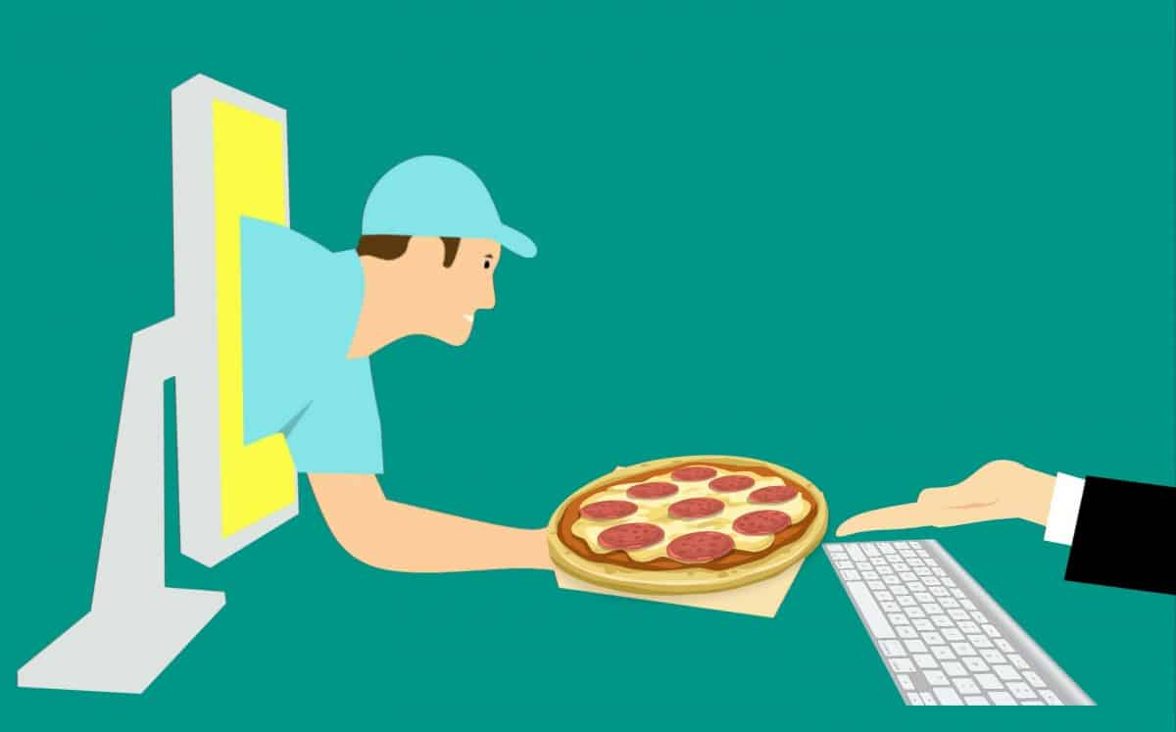
Online Food Demand Forecast

Slide 2
About the Business
Client is a meal delivery company
Operates in Multiple cities.
Each city -> Many fulfillment centers
Each fulfillment centers -> Many meals

Slide 3

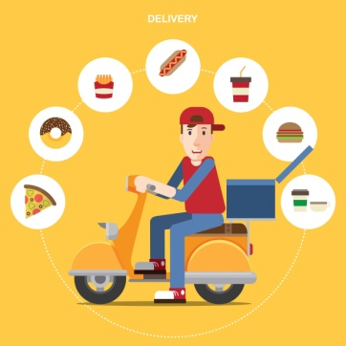
Why the forecast
Raw material are perishable in nature
Effective human resource planning

Slide 4

Problem Statement
The client wants you to help the centers with demand forecasting for upcoming weeks so that these centers will plan the stock of raw materials accordingly.
The task is to predict the demand for the next 10 weeks (Weeks: 146-155) for the center-meal combinations in the test set

Slide 5
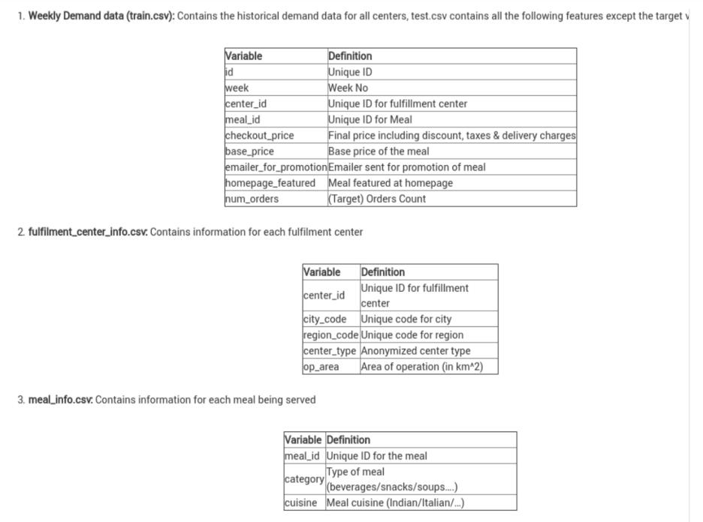
DATA

Slide 6
DATA
Historical data of demand for a product-center combination
(Weeks: 1 to 145)
Product(Meal) features such as category, sub-category, current price and discount
Information for fulfillment center like center area, city information etc.

Slide 7
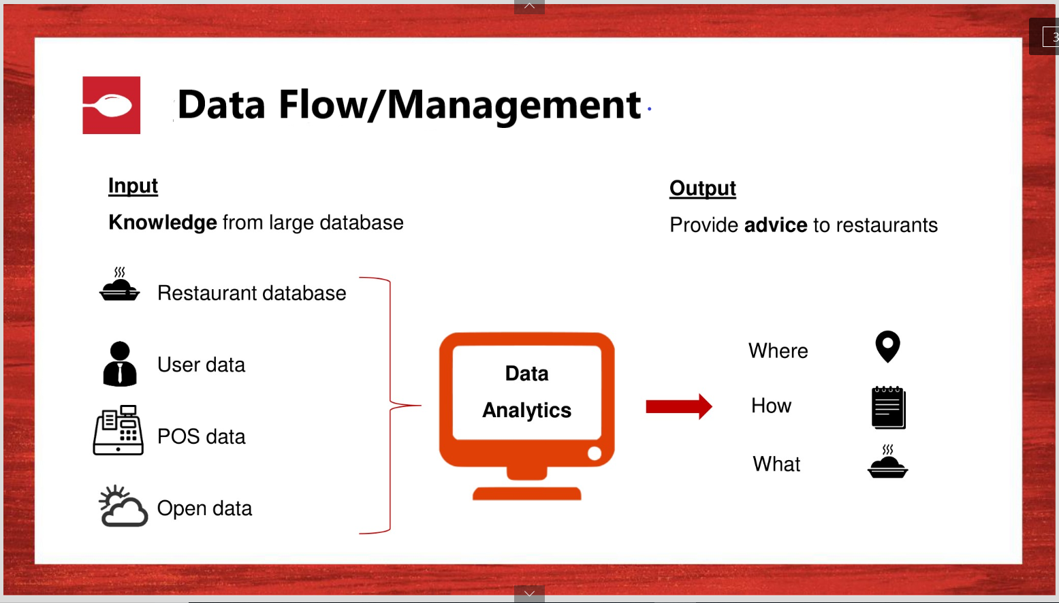

Slide 8
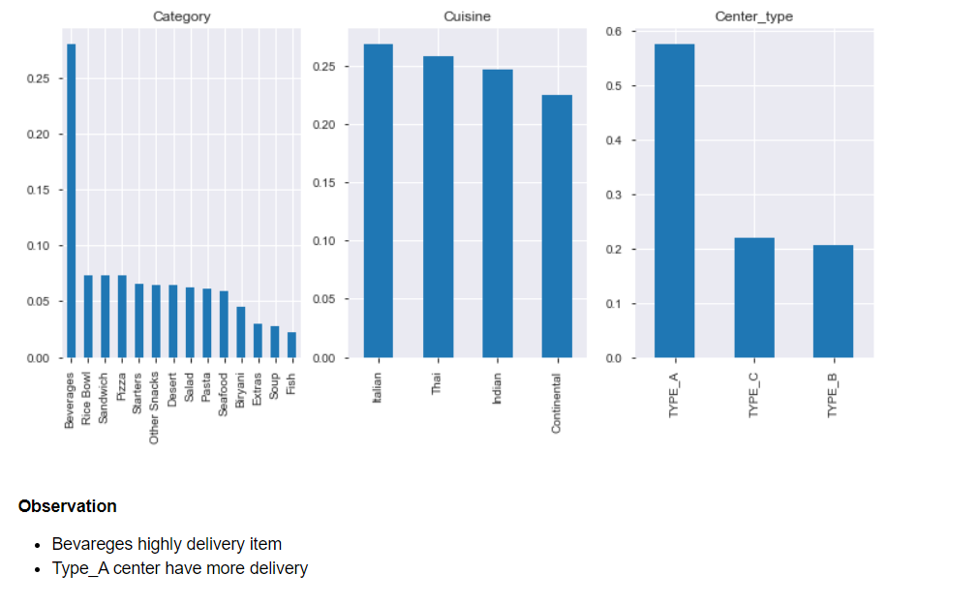
Data understanding

Slide 9
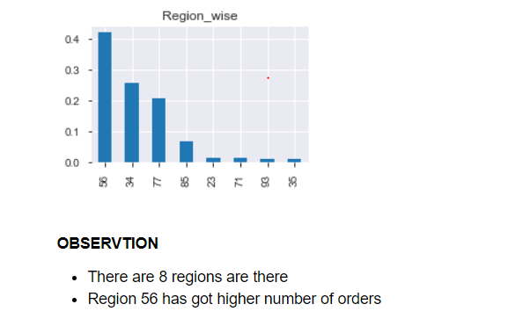
Data understanding-Contd….

Slide 10
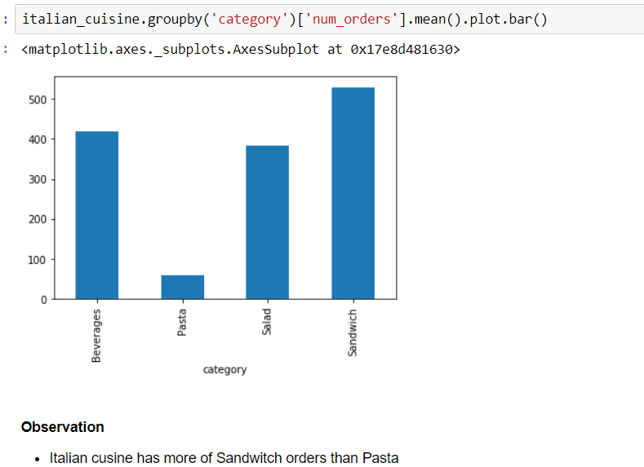
Data understanding-Contd….

Slide 11
APPROaCH
Data Preprocessing
Creation of unique_id for Center(55) and Meal_id(1033)
Use Timeseries models (ARIMA, SARIMA, SARIMAX) to forecast
Decompose the dataset
Ploting ACF, PACF plots
Use Neural Networks – LSTM
Build LSTM model for full dataset
Build LSTM model for single Center+meal_id combination

Slide 12
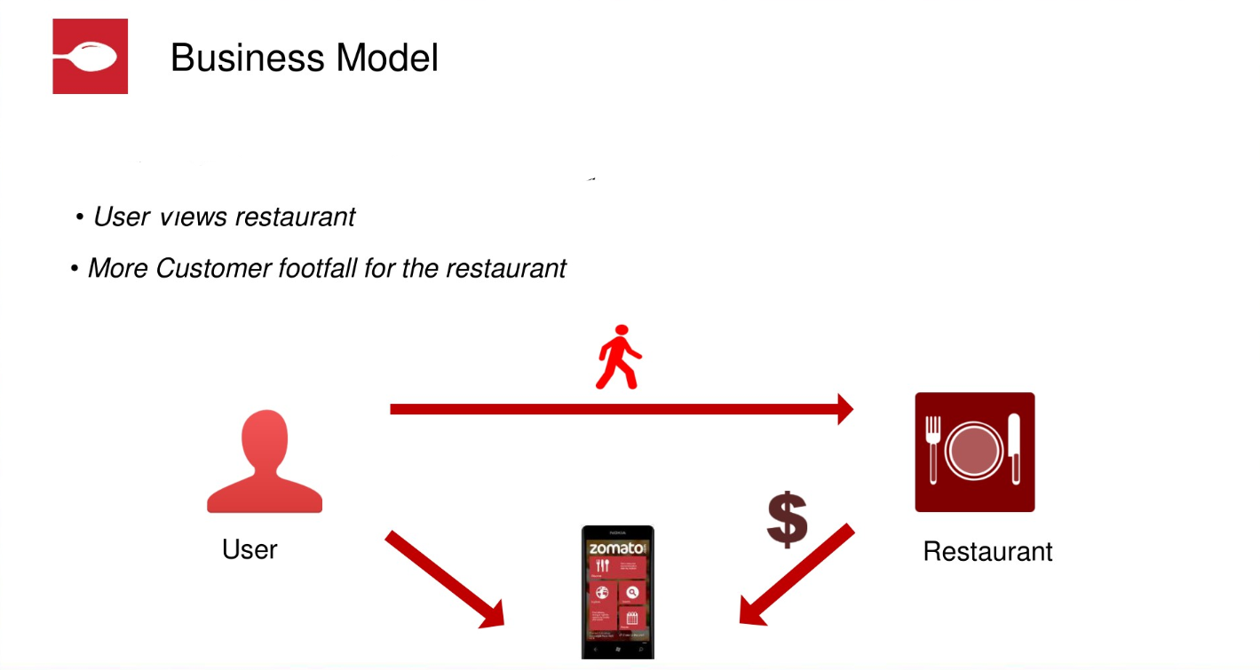

Slide 13
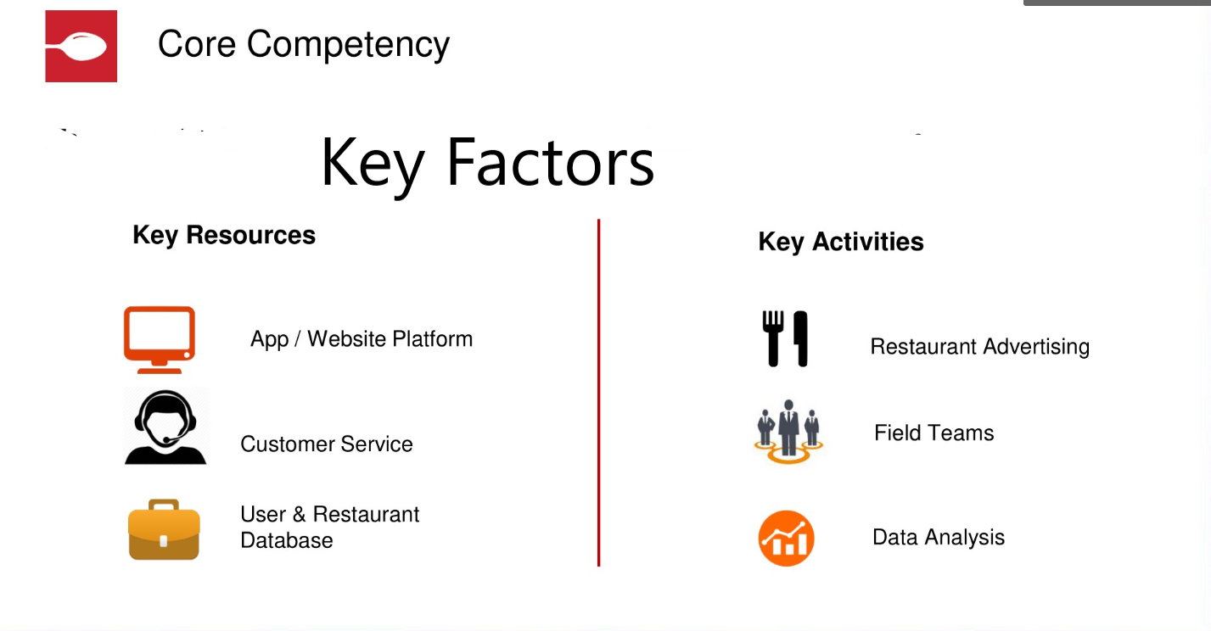

Slide 14
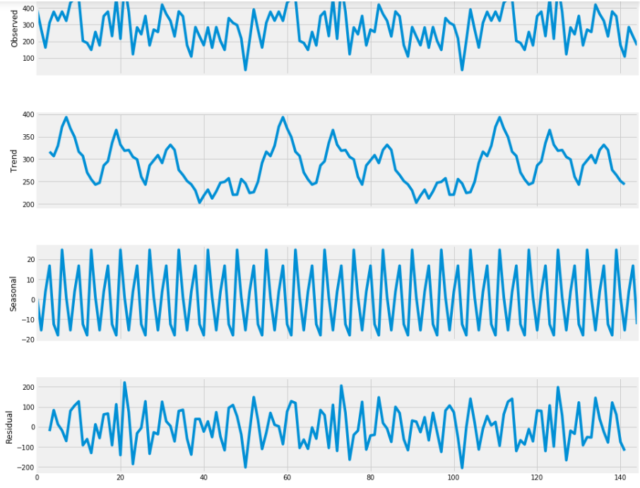
Decomposing the data

Slide 15
Stationarize the data

Slide 16
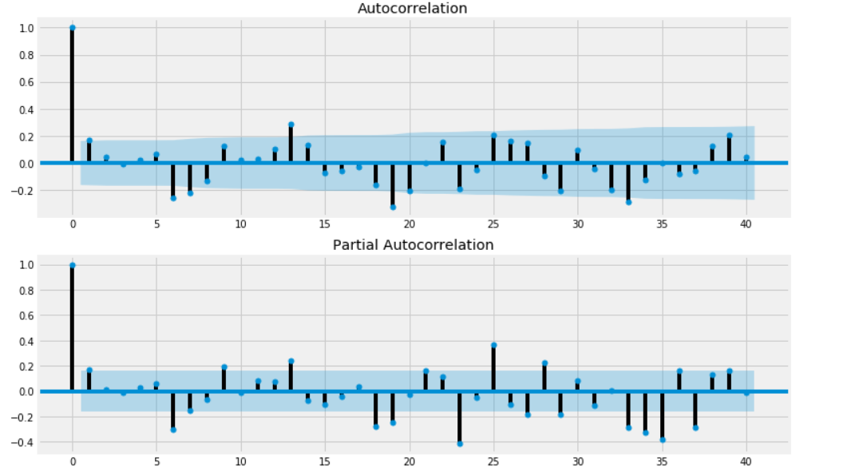
Plotting the Data

Slide 17
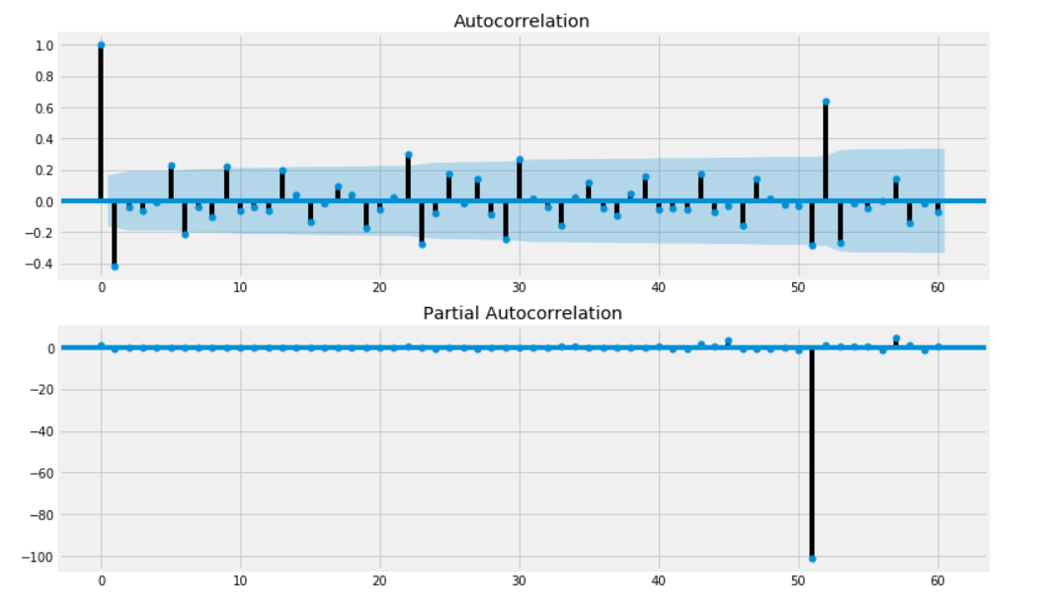
ACF, PACF plotting on differencing data

Slide 18
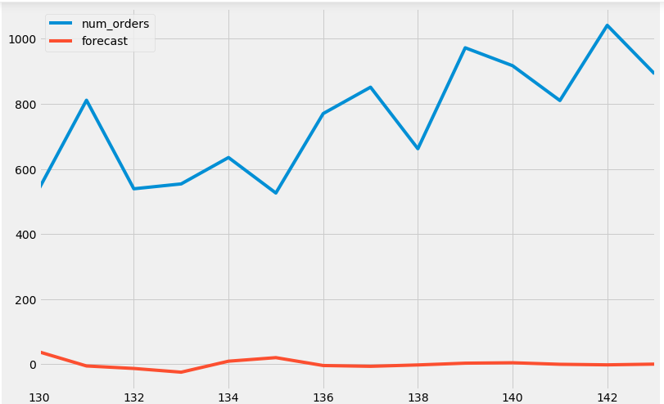
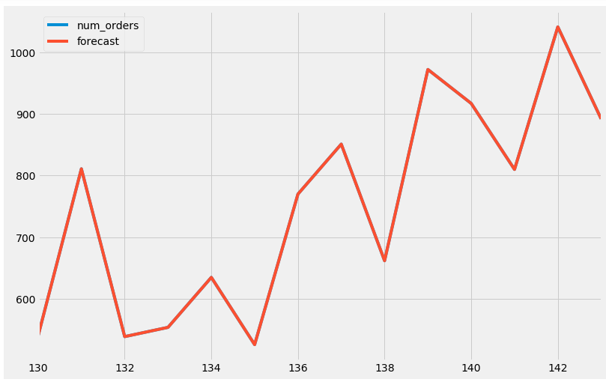
Model Prediction
ARIMA Model
SARIMA Model

Slide 19
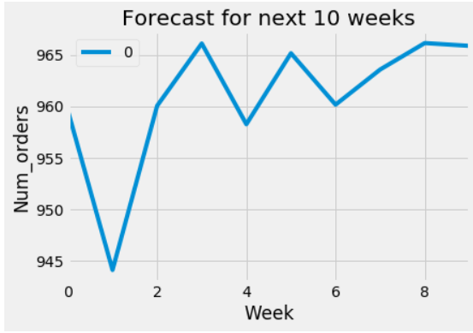
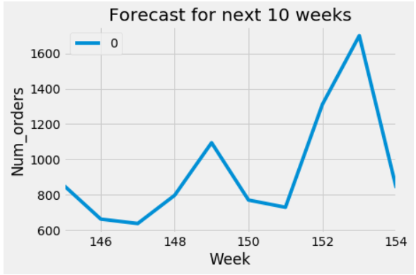
Model Forecast for future 10 weeks
ARIMA
SARIMA

Slide 20
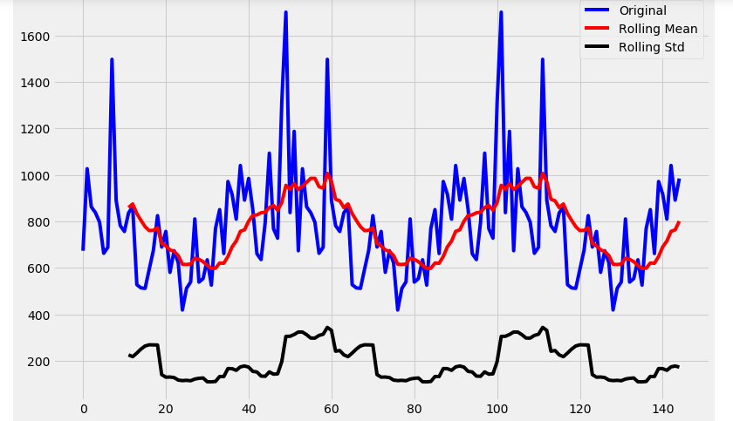
Original Data to compare

Slide 21
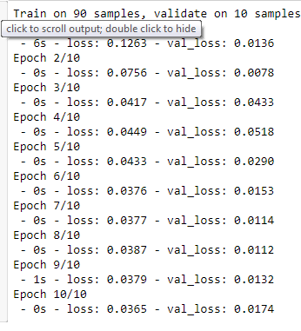
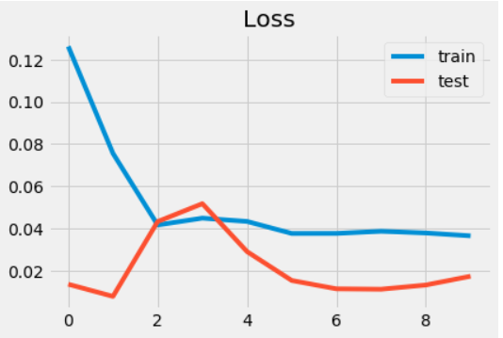
LSTM Model
Model Performance:
Epoch details:

Slide 22
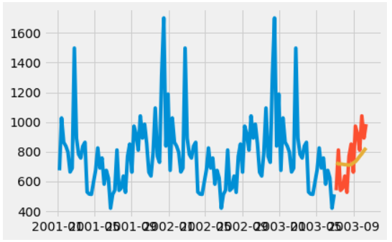
LSTM Prediction on Validation Data

Slide 23
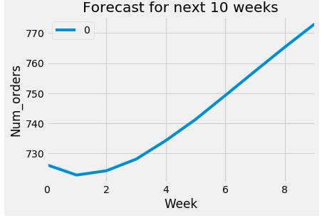
LSTM forecast on future 10 weeks

Slide 24
Future work in this project
We forecasted for only one centerId_Meal_ID combination.
Need to forecast for each CenterID_MealID combination.
SARIMAX model to focus on independent variables.

Slide 25


